Slide 1

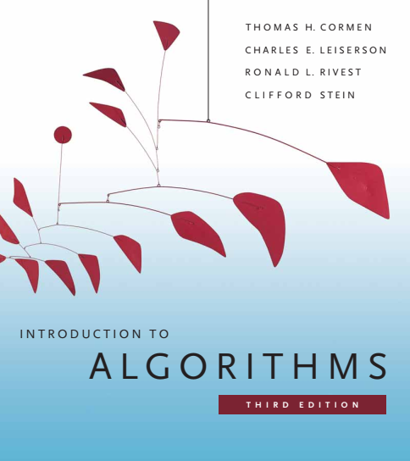
Design and Analysis of Algorithms
Dr. Sajid Iqbal
sajidiqbal.pk@gmail.com
Reference Book
Introduction to Algorithms 3rd Edition By Thomas H. Cormen et. al.
https://mitpress.mit.edu/books/introduction-algorithms-third-edition
COMEDXD

Slide 2
Basic Data Structures
Representing rooted trees

Slide 3




Introduction
Linked lists can be used to represent rooted trees
A tree may contain homogeneous and heterogeneous data
In this lecture, we assume homogeneous data in tree
A tree node can be considered as an object
The structure of node may vary depending upon the tree type
Unary Tree
$$P_{parent}$$ | $$Key$$ | $$P_{child}$$
Binary Tree
$$P_{parent}$$ | $$Key$$ | $$P_{left−child}$$ | $$P_{right−child}$$
3-ary Tree
$$P_{parent}$$ | $$Key$$ | $$P_{child1}$$ | $$P_{child2}$$ | $$P_{child3}$$
n-ary Tree
$$P_{parent}$$ | $$Key$$ | $$P_{child1}$$ | $$P_{child2}$$ | … | $$P_{childn}$$

Slide 4
Rooted trees with unbounded branching
A tree may have undefined number of children nodes
we do not know how many attributes to allocate in advance.
Even if the number of children k is defined, most nodes have a small number of children, we may waste a lot of memory
Instead of having a pointer to each of its children, each node x has only two pointers:
Left-child: A pointer that points to left child
Right-sibling: this pointer points to next child that is present on right side

Slide 5
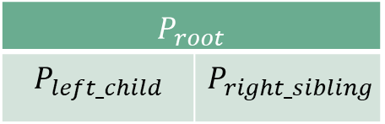
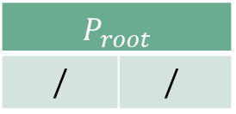

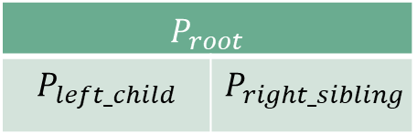
$$P_{root}$$
$$P_{left_child}$$ | $$P_{right_sibling}$$

Slide 6

Thanks for watching
Dr. Sajid Iqbal
Assistant Professor
Department of Computer Science
Bahauddin Zakariya University, Multan
sajidiqbal.pk@gmail.com
Slides: https://github.com/sajjo79/Design_and_Analysis_of_Algorithms
YouTube Channel: COMEDXD
Allah Hafiz

